Slide 1
Power and Politics (Part A)

Slide 2

A Definition of Power
Power
The capacity that A has to influence the behavior of B so that B acts in accordance with A’s wishes
Exists as a potential or fully actualized influence over a dependent relationship
Dependency
B’s relationship to A when A possesses something that B requires
The greater B's dependence, the more power A has
Notes:
Power refers to the capacity one person has over the other person to get them to do what they want. Inherent in this definition is the idea of dependency. The stronger the relationship or the dependency that one person has when the other possesses something they want or requires, the greater the dependency on that person.

Slide 3
Contrasting Leadership and Power
Leadership
Power
Focuses on goal achievement
Requires goal compatibility with followers
Focuses influence downward
Research Focus
Leadership styles and relationships with followers
Used as a means for achieving goals
Requires follower dependency
Used to gain lateral and upward influence
Research Focus
Power tactics for gaining compliance
Notes:
Leadership and power are two different concepts and need to be defined separately. Leadership is focusing on goal achievement along with their followers. Power is used as a way to accomplish the goal and often followers are also means to accomplish the goal. Leadership will focus on using their leadership downward to influence others to help them achieve their tasks. Whereas power uses influence to gain something upward or laterally.

Slide 4
Bases of Power: Formal Power
Formal Power
Established by an individual’s position in an organization
Three bases:
Coercive Power
A power base dependent on fear of negative results
Reward Power
Compliance achieved based on the ability to distribute rewards that others view as valuable
Legitimate Power
The formal authority to control and use resources based on a person’s position in the formal hierarchy
Notes:
There are two main bases of power, formal and personal. Formal power is defined more by the position a person will hold in the organization. A person with formal power can utilize different power bases to accomplish their tasks. The first is coercive power where employees fear negative consequences if they don’t do what they are told. Reward power is the ability to distribute rewards that others see as valuable and they will thereby accomplish the goals or tasks to get the reward. The last base is legitimate power where the formal authority to control and use resources is then based on the person’s position in the formal hierarchy.

Slide 5
Bases of Power: Personal Power
Power that comes from an individual’s unique characteristics – these are the most effective
Expert Power
Influence based on special skills or knowledge
Referent Power
Influence based on possession by an individual of desirable resources or personal traits
An example of referent power is when a celebrity endorses a product. People are influenced to buy the product because they admire and want to emulate the celebrity's lifestyle or traits.
Notes:
The second major form of power is personal power which comes through the individual’s personality and characteristics. This is often more effective than formal power. Personal power can be based on expert power, the individual’s special skills or knowledge or referent power, as well as their influence based on the personal traits or resources they can offer to others.

Slide 6
Dependency: The Key to Power
The General Dependency Postulate
The greater B’s dependency on A, the greater the power A has over B
Possession/control of scarce organizational resources that others need makes a manager powerful
Access to optional resources (e.g., multiple suppliers) reduces the resource holder’s power
Dependency increases when resources are:
Important
Scarce
Nonsubstitutable
Notes:
Central to the concept of power is dependency. The greater a person’s dependency on another, the more power they hold over that person. When resources are very important, scarce, or there is no easy substitute, then the use and amount of power will rise in an organization.

Slide 7
Power Tactics
Power Tactics
Ways in which individuals translate power bases into specific actions
Nine influence tactics:
Legitimacy
Rational persuasion*
Inspirational appeals*
Consultation*
Exchange
Personal appeals
Ingratiation
Pressure
Coalitions
* Most effective
(Pressure is the least effective)
Notes:
There are a number of power tactics an individual can use or ways in which they can make the power base work for them by moving people into specific actions. Nine different tactics are mentioned in this slide and include things like rational persuasion, personal appeals, and pressure.

Slide 8
Preferred Power Tactics by Influence Direction
Upward Influence | Downward Influence | Lateral Influence
Rational persuasion | Rational persuasion | Rational persuasion
 | Inspirational appeals | Consultation
 | Pressure | Ingratiation
 | Consultation | Exchange
 | Ingratiation | Legitimacy
 | Exchange | Personal appeals
 | Legitimacy | Coalitions
Notes:
Depending on the direction of the influence that is desired, different tactics will be more effective. This slide takes a look at the preferred power tactics by influence direction. For example, if you need to influence those above you in the organization, rational persuasion is the best method as things like exchange or pressure won’t work because your power base is low.

Slide 9
Factors Influencing Power Tactics
Choice and effectiveness of influence tactics are moderated by:
Sequencing of tactics
Softer to harder tactics work best
Political skill of the user
The culture of the organization
Culture affects user’s choice of tactic
Notes:
Many factors can influence the effectiveness of the power tactics discussed. Their ability to encourage the desired behavior could depend on the sequencing of the tactics. It is often better to start with softer tactics, such as exchange, and work up to harder tactics such as pressure. The success of the tactics will, however, greatly depend on the political skill of the user and the context or culture of the organization.

Slide 10
Soft & Hard Tactics
People complying with soft tactics tend to be
Reflective
Intrinsically motivated
Greater self esteem
Greater desire for control
People complying with hard tactics tend to be
Action oriented
Extrinsically motivated
Focused on getting along with others.

Slide 11
Power and Politics (Part B) Political Skill: Dimensions
Researchers suggest it should be considered in hiring and promotion decisions
The Four Key dimensions:
Social Astuteness( accurate perception and evaluation of social situations)
Interpersonal Influence ( subtle and influential personal style that is effective in getting things done)
Networking( ( individual’s capacity to develop and retain diverse and extensive social networks)
Sincerity(An individual’s ability to portray forthrightness and authenticity in their dealings)

Slide 12
Culture of the Organisation
Individualistic countries see power in
Personalized terms
Rational Appeal
Collectivist countries see power in
Social power
Coalition

Slide 13
Sexual Harassment: A Case of Unequal Power
Sexual Harassment:
Any unwanted activity of a sexual nature that affects an individual’s employment and creates a hostile work environment
Overt actions, like unwanted touching, are relatively easy to spot
Subtle actions, like jokes or looks, can cross over the line into harassment
Sexual harassment isn’t about sex – it is about abusing an unequal power relationship
Harassment can damage the well-being of the individual, work group, and organization
Notes:
An extreme case of unequal power is sexual harassment and is a growing area of concern for organizations. Sexual harassment is defined as any unwanted activity of a sexual nature that affects an individual’s employment and creates a hostile work environment. Harassment of this nature is not about sex itself, it is more about the abuse of power in an unequal relationship.
Harassment has many damaging effects on the person being harassed, on the harasser, and on the organization. It is something organizations take very seriously given the rise in lawsuits in this area over the last decade.

Slide 14
Managerial Actions to Prevent Sexual Harassment
Make sure a policy against it is in place.
Ensure that employees will not encounter retaliation if they file a complaint.
Investigate every complaint and include the human resource and legal departments.
Make sure offenders are disciplined or terminated.
Set up in-house seminars and training.
Notes:
Managers can help prevent most cases of sexual harassment in the workplace by following some guidelines.
First, it is important to make sure a clear and strong policy against sexual harassment is in place. Let employees know about the policy and that if they file a complaint, they will not encounter retaliation. Investigate every complaint and be sure to include parties who can help you in the process, such as human resources and the legal department. If offenders are identified, they need to be disciplined or terminated. Finally, be sure to train employees on sexual harassment through in-house seminars and training.

Slide 15
Politics: Power in Action
Political Behavior
Activities that are not required as part of one’s formal role in the organization, but that influence, or attempt to influence, the distribution of advantages or disadvantages within the organization
Legitimate Political Behavior
Normal everyday politics - complaining, bypassing, obstructing
Illegitimate Political Behavior
Extreme political behavior that violates the implied rules of the game: sabotage, whistle-blowing, and symbolic protest
Notes:
Political behavior is defined as activities that are not required as part of the job, but that impacts the way benefits and punishments are distributed within the organization.
Political behavior can take the form of legitimate or illegitimate behavior. Legitimate political behavior is everyday normal politics such as complaining, bypassing, or obstructing. Illegitimate political behavior is more extreme and violates the implied rules of the game such as sabotage, whistle blowing, and symbolic protest, which includes things such as wearing protest buttons or calling in sick as a group.

Slide 16
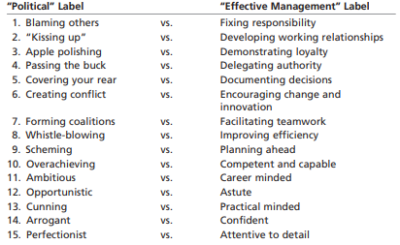
Observer’s perception

Slide 17
The Reality of Politics
Politics is a natural result of resource scarcity
Limited resources lead to competition and political behaviors
Judgments on quality of resource distribution differ markedly based on the observer’s perception
“Blaming others” or “fixing responsibility”
“Covering your rear” or “documenting decisions”
“Perfectionist” or “attentive to detail”
Most decisions are made under ambiguous conditions
Lack of an objective standard encourages political maneuvering of subjective reality
Notes:
Politics often occurs when resources are low – the excess demand for the resources leads to competition and political behaviors. When the scarce resources are distributed, there will be varying views regarding how “fairly” or “effectively” the distribution was done. Perceptions can be distorted such that the manager feels they are documenting decisions and the employee just feels that the manager is covering his/her rear.
Most of the time, managers are making decisions under ambiguous conditions and there is not a readily available objective standard. This creates a context in which political maneuvering is encouraged.

Slide 18
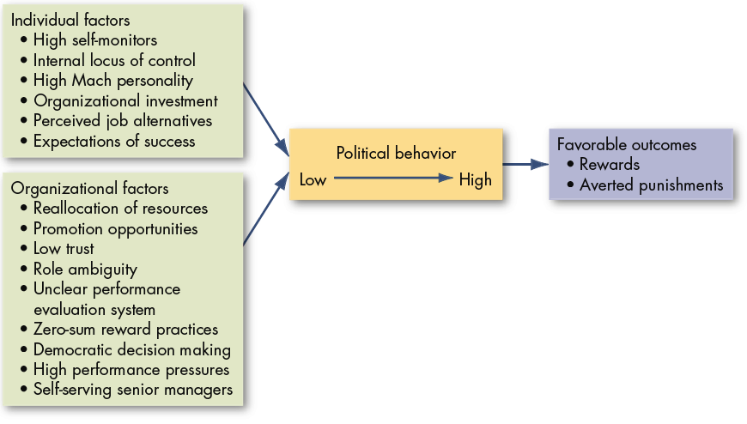
Causes and Consequences of Political Behavior
Factors that Influence Political Behavior
Notes:
There are a number of factors that influence political behavior. These factors include individual factors such as those with high mach personalities or high expectations of success, as well as organizational factors such as a culture of low trust and role ambiguity. The combination of these factors will lead to political behavior which can lead to favorable outcomes such as increased rewards or decreased punishments.

Slide 19
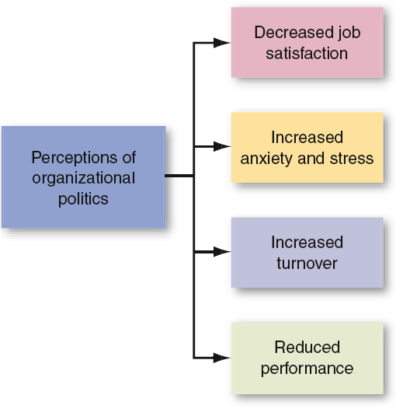
Employee Responses to Organizational Politics
Most employees have low to modest willingness to play politics and have the following reactions to politics:
Notes:
Most employees will not engage in a high level of politics and often react negatively to politics. Their reactions include decreased job satisfaction, increased anxiety and stress, increased turnover, and a reduction in performance. Even though the given outcome for the individual employee who engages in politics may be favorable, it is often a negative impact for the group as a whole.

Slide 20
Defensive Behaviors
Employees who perceive politics as a threat have defensive reactions
May be helpful in the short run, dangerous in the long run
Types of defensive behaviors
Avoiding Action
Overconforming, buck passing, playing dumb, stalling
Avoiding Blame
Bluffing, playing safe, justifying, scapegoating
Avoiding Change
Prevention, self-protection
Notes:
Politics often put employees on the defense. When employees are acting defensively, they will behave in ways that hurt the team and organization in the long run. Some defensive behaviors include avoiding action by overconforming and stalling; avoiding blame by playing it safe or blaming it on someone else; and avoiding change by preventing action or protecting themselves.

Slide 21
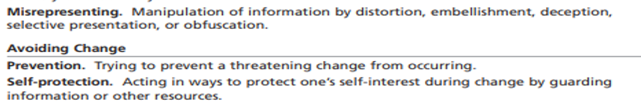
Overconforming: This means going along with others even if you don't agree, just to avoid conflict or gain approval.
Buck Passing: It's when someone avoids taking responsibility for something by blaming others
Playing Dumb: This is pretending not to know or understand something, often to avoid responsibility or accountability.
Stalling: It means delaying or dragging out a situation or task, usually to gain more time or avoid making a decision.
Bluffing: Being deceptive or pretending to have something you don't.
Playing Safe: Preferring caution over taking risks.
Justifying: Judging or explaining actions to make them seem acceptable.
Scapegoating: Shifting blame onto others to avoid accountability.

Slide 22
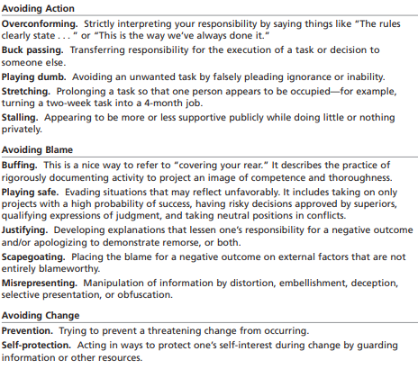
Defensive Behaviors

Slide 23
Impression Management (IM)
Impression management is the process of controlling or influencing how others perceive us
IM Techniques
Conformity
Excuses
Apologies
Self-Promotion
Flattery
Favors
Enhancement
Exemplification
Notes:
Impression Management is a response to political behavior and is defined as the process by which individuals attempt to control the impression others form of them. Some techniques used to manage this impression are conformity, self-promotion, favors, and association.

Slide 24
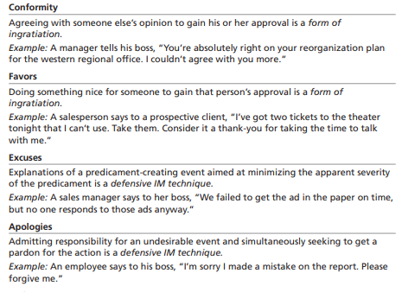
IM Techniques

Slide 25
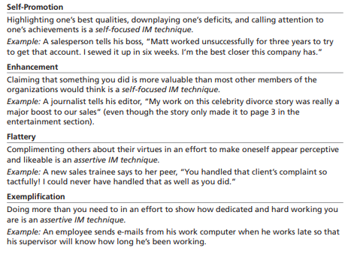
IM Techniques

Slide 26
IM Effectiveness
Job Interview Success
IM does work and most people use it
Self-promotion techniques are important
Ingratiation is of secondary importance
Performance Evaluations
Ingratiation is positively related to ratings
Self-promotion tends to backfire
Notes:
Impression management has shown to be effective in different situations, such as job interviews and performance evaluations. It is important that in an interview, you set forth a positive impression. Many applicants utilize IM to get the interviewer to like them. Self-promotion is seen as important because it shows confidence, however in an interview ingratiation is not as effective. Albeit, in performance evaluations ingratiation has been found to be a positive technique and linked to higher rankings. However, self-promotion does not work as well in this context.
You must be aware of your context when utilizing IM techniques in order to get the outcome desired.

Slide 27
The Ethics of Behaving Politically
It is difficulty to tell ethical from unethical politicking
Three questions help:
What is the utility of engaging in the behavior?
Does the utility balance out any harm done by the action?
Does the action conform to standards of equity and justice?
Answers can be skewed toward either viewpoint
Notes:
Is political behavior ethical in the workplace? Well, the answer is probably yes and no. It is difficult to tell ethical from unethical politicking. There are three questions that can help define ethical/unethical political behavior:
What is the utility of engaging in the behavior?
Does the utility balance out any harm done by the action?
Does the action conform to standard of equity and justice?
The answers to these questions can lead you to decide if the behavior is ethical or unethical.

Slide 28
Global Implications
Politics Perceptions
The perception of politics can have negative effects in various parts of the world.
Preference for Power Tactics
Effective strategies for gaining power depend a lot on the culture of the country where they're used.
Effectiveness of Power Tactics
Still open to debate; too little research has been done
(There's still uncertainty about how well different power tactics work, as there hasn't been enough research done on the topic)
Notes:
Politicking in the workplace is done around the globe and the perception of politics seems to be consistently negative in most cultures. However, there is a difference between what power tactics are effective and it varies by cultural acceptance and norms. There has not been a lot of research done to determine which tactics are effective in which cultures, so that is an area that is still open to debate.

